Slide 1
Windows Tech Series Browsers
Speaker 1
Title
Speaker 2
Title

Slide 2
Agenda
Day | Day 1 Deployment | Day 2 Management | Day 3 Security | Day 4 Windows for CSP
 |  |  |  | Deployment | Management | Security
Synopsis | Module 1 – Introduction | Module 1 – Base System Setup | Module 1 – Analysis Of Common Threats | Module 1 – Windows for SMB Partners
 | Module 2 – Applications & Updates | Module 2 – Configuration | Module 2 – Hardening Windows | Module 2 – Windows Ent. Subscription
 | Module 3 – Windows as a Service (WaaS) | Module 3 – Managing Client Devices | Module 3 – Advanced Threat Protection | Module 3 – Deployment
 | Module 4 – Browsers & Internet Security | Module 4 – Advanced management options I | Module 4 – Information Security (AIP/WIP) | Module 4 – Managing Updates
 | Module 5 – Secure Boot & Device Guard | Module 5 - Advanced management options II | Module 5 – Internet Security

Slide 3
What we heard from CUSTOMERS
We need a browser that just works with modern web sites and services
Microsoft Edge is always up-to-date and focuses on interoperability with the modern web
I’m worried about Internet security threats and the risk to my business
Microsoft Edge is a safer browser, with protection against modern security threats
My employees need to be productive when browsing the web
Microsoft Edge goes beyond browsing with built-in features like Cortana, Web Note, and PDF viewing
We have thousands of legacy web apps and need to extend our existing web app investments
Microsoft Edge can fall back to Internet Explorer 11 just for sites that need backward compatibility
What we CREATED

Slide 4
What we heard from CUSTOMERS
We need a browser that just works with modern web sites and services
Microsoft Edge is always up-to-date and focuses on interoperability with the modern web
I’m worried about Internet security threats and the risk to my business
Microsoft Edge is a safer browser, with protection against modern security threats
My employees need to be productive when browsing the web
Microsoft Edge goes beyond browsing with built-in features like Cortana, Web Note, and PDF viewing
We have thousands of legacy web apps and need to extend our existing web app investments
Microsoft Edge can fall back to Internet Explorer 11 just for sites that need backward compatibility
What we CREATED

Slide 5
What we heard from CUSTOMERS
We need a browser that just works with modern web sites and services
Microsoft Edge is always up-to-date and focuses on interoperability with the modern web
I’m worried about Internet security threats and the risk to my business
Microsoft Edge is a safer browser, with protection against modern security threats
My employees need to be productive when browsing the web
Microsoft Edge goes beyond browsing with built-in features like Cortana, Web Note, and PDF viewing
We have thousands of legacy web apps and need to extend our existing web app investments
Microsoft Edge can fall back to Internet Explorer 11 just for sites that need backward compatibility
What we CREATED

Slide 6
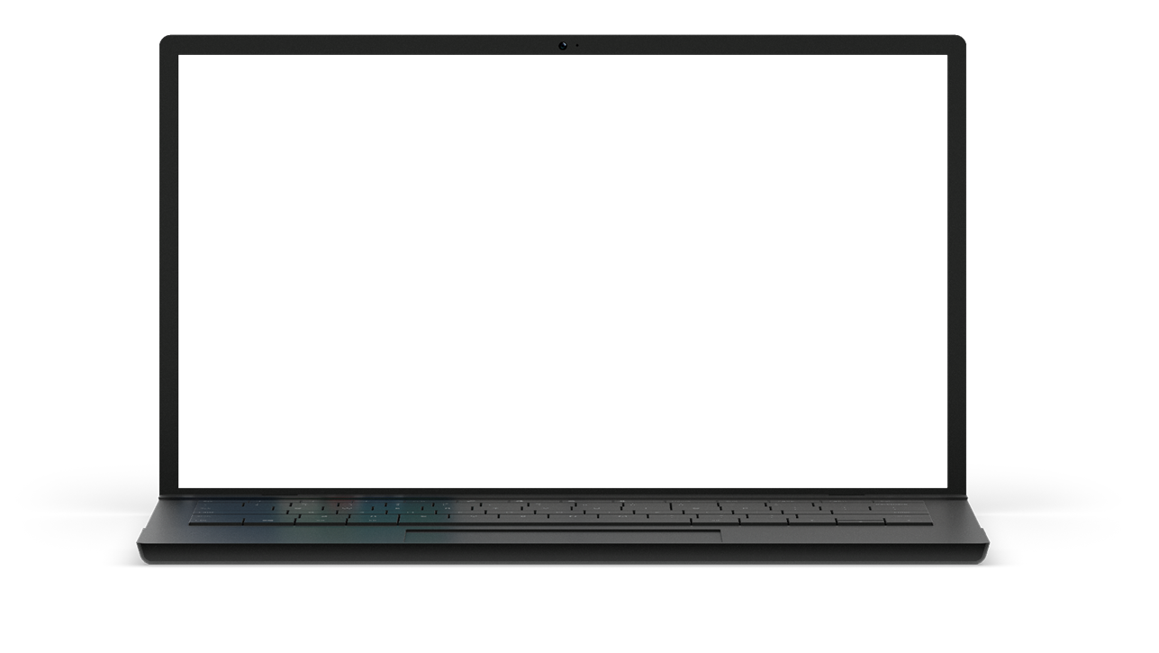
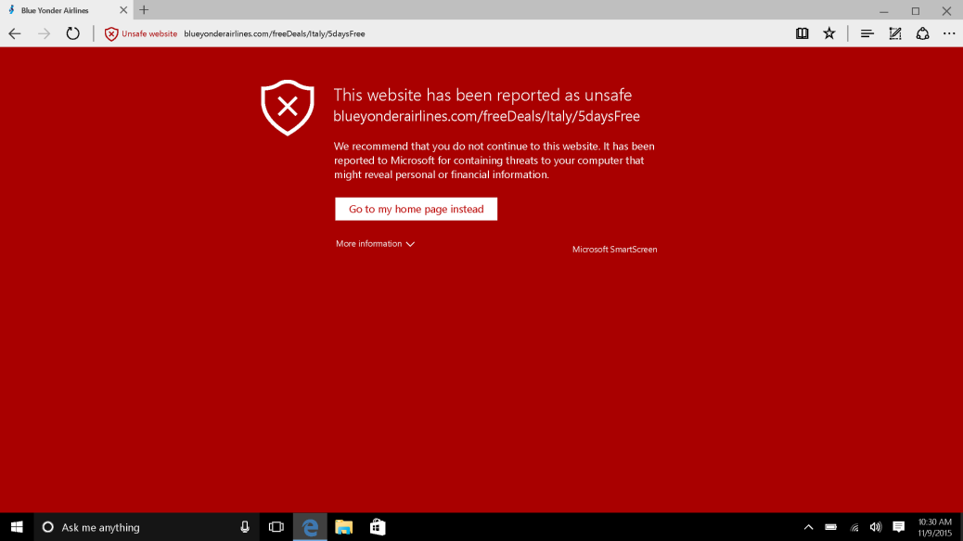
PROACTIVE THREAT IDENTIFICATION AND PROTECTION
Microsoft SmartScreen
Phishing and malware filtering technology for Microsoft Edge and Internet Explorer 11 in Windows 10.
Provides protection from drive-by attacks.
Cloud service is continuously updated, nothing for you to deploy.
Exchange Online Advanced Threat Protection
Cloud-based email filtering service helps protect against unknown malware and viruses.
URL trace technology examines potentially harmful links.

Slide 7
Microsoft Edge: Designed for Secure Browsing
Microsoft Edge is the most secure browser Microsoft has ever shipped
Tactics
Objective
Strategy
Eliminate vulnerabilities before attackers can find them
Make it difficult and costly for attackers to find and exploit vulnerabilities in Microsoft Edge
Keep our customers safe when browsing the web
→
→
Break exploitation techniques used by attackers
Contain the damage when vulnerabilities are discovered
Prevent navigation to known exploit sites

Slide 8
Microsoft Edge: BUILDING A SAFER BROWSER
Fundamentally improve security and enable users to confidently experience the web when using Windows 10
www
Defend users
Defend the browser
Identify and block known trickery and fraud
New model for safer browser extensions, extended defenses again memory corruption
Defend against malicious web sites and downloads (SmartScreen)
Stronger, and more convenient, credentials that attackers cannot steal
(Microsoft Passport and Windows Hello)
Supporting new web security standards to block common attacks and prevent impersonation
(Cert. Reputation, EdgeHTML, W3C Content Security Policy,
HTTP Strict Transport Security)
Microsoft Edge is an app, sandboxed by default
(Universal Windows Platform)
Memory randomization space increased dramatically
(Windows Address Space Layout Randomization on 64-bit systems)
Automate memory cleanup, even if program does not
(MemGC)
Dev tools to make it significantly more difficult
to take over an application
(Control Flow Guard)

Slide 9

Microsoft Edge SECURITY Improvements
Before – Full access to Win32.sys
Microsoft Edge and Flash no longer have full access to win32k.sys—API calls are filtered
Only 40% of interfaces are available to Flash and Edge reducing attack surface
Flash player move into its own AppContainer
Working directly with Adobe to harden Flash player to be resistant to vulnerability exploits
Windows Kernel
Microsoft Edge Browser
Edge Content Process
Win32k.sys
Flash Host Process
Today – 60% less surface area of attack on a highly targeted library
Windows Kernel
Microsoft Edge Browser
Edge Content Process
Allowed Win32k.sys interfaces
Flash Host Process
Blocked Win32k.sys interfaces

Slide 10

Microsoft Edge
Windows Defender Application Guard enabling the most secure browsing experience
Windows Defender Application Guard protects the device from advanced attacks launched against Microsoft Edge
Malware and vulnerability exploits targeting the browser, including zero days, are unable to impact the operating system, apps, data and network
Application Guard uses virtualization based security to hardware isolate to isolate Microsoft Edge and any browsing activity away from the rest of the system
Closing Microsoft Edge wipes all traces of attacks that may been encountered while online

Slide 11


Hardware isolation with
Windows Defender application Guard
Microsoft Edge
Apps
Windows Platform Services
Windows Platform Services
Critical System Processes
Kernel
Kernel
Kernel
Windows Defender
Application Guard Container
Windows Operating System
System Container
Hyper-V
Hyper-V
Device Hardware
Hypervisor

Slide 12
Microsoft Edge: Attack surface reduction
With Microsoft Edge, we seized the opportunity to drastically reduce the attack surface exposed to the web
No legacy document modes
No legacy script engines (VBScript, JScript)
No Vector Markup Language (VML)
No Toolbars
No Browser Helper Objects (BHOs)
No ActiveX controls
Much less code than Internet Explorer!
Tactic | Applies To | First Shipped
Eliminate vulnerabilities | Microsoft Edge on Windows 10 | July, 2015 (Windows 10 RTM)

Slide 13
Microsoft Edge Security Assurance
Microsoft Edge was built together with in house security experts
Fuzzing/Static Analysis
Code Review/Penetration Testing
REDTEAM
Greater than 670 machine years devoted to fuzz testing Microsoft Edge and Internet Explorer during development
More than 400 billion DOM manipulations generated from 1 billion html files
Hundreds of security issues addressed
Security review of all key features resulted in over 70 security review engagements
Dozens of security implementation and design issues addressed prior to ship
Security static analysis checkers integrated into Edge builds and
Windows REDTEAM emulates the techniques and expertise of skilled real-world attackers
Exploited Microsoft Edge vulnerabilities discovered through penetration testing
End result in improved mitigation of new novel attacks discovered prior to shipping Microsoft Edge
Ongoing Microsoft “Bug Bounty” Programs

Slide 14
Measuring Microsoft Edge Security Improvements
Number of exploited web browser CVEs
Number of days with known zero day exploit in the wild
Number of RCE CVEs by web browser version
Number of exploited Microsoft web browser Remote Code Execution (RCE) CVEs by patch year
Number of days with known Microsoft web browser Remote Code Execution (RCE) zero day in the wild before patch
Number of Remote Code Execution (CVEs) addressed in 2015 by web browser version
No known zero day exploit for a Microsoft RCE CVE that works against IE11 on Windows 8.1+ for 19 months
No known exploits in-the-wild that target Microsoft Edge
75% reduction in RCE CVEs that affect Microsoft Edge in the first 5 servicing months

Slide 15
What we heard from CUSTOMERS
We need a browser that just works with modern web sites and services
Microsoft Edge is always up-to-date and focuses on interoperability with the modern web
I’m worried about Internet security threats and the risk to my business
Microsoft Edge is a safer browser, with protection against modern security threats
My employees need to be productive when browsing the web
Microsoft Edge goes beyond browsing with built-in features like Cortana, Web Note, and PDF viewing
We have thousands of legacy web apps and need to extend our existing web app investments
Microsoft Edge can fall back to Internet Explorer 11 just for sites that need backward compatibility
What we CREATED

Slide 16
“Beyond Browsing” Demos
MicrosoftEdgeInsider.com

Slide 17
What we heard from CUSTOMERS
We need a browser that just works with modern web sites and services
Microsoft Edge is always up-to-date and focuses on interoperability with the modern web
I’m worried about Internet security threats and the risk to my business
Microsoft Edge is a safer browser, with protection against modern security threats
My employees need to be productive when browsing the web
Microsoft Edge goes beyond browsing with built-in features like Cortana, Web Note, and PDF viewing
We have thousands of legacy web apps and need to extend our existing web app investments
Microsoft Edge can fall back to Internet Explorer 11 just for sites that need backward compatibility
What we CREATED

Slide 18
Legacy App Compat Demos
Configuring Enterprise Mode Site List, Restricting Internet Explorer 11

Slide 19
What Else Is New
Easier IE11 Transitions:
Microsoft Edge can switch automatically to Internet Explorer 11 for sites on your Enterprise Mode Site List, with no interstitial page. Internet Explorer 11 can switch back to Microsoft Edge for all other sites.
Favorites:
You can opt to show only the icons of the what’s saved on your favorites bar or both the icon and the name of the site.
You can now import your favorites from Firefox. (Details included in the Favorites section)
Clear browsing data on exit:
You can now choose to have your browsing data cleared when you exit Microsoft Edge. Just click on the three dots at the top right in Microsoft Edge and go into Settings, click on the “Choose what to clear” button under “Clear browser data” and enable “Always clear this after I close the browser” after choosing what data you want cleared.
Extensions:
Microsoft Edge is already great for browsing the web, but now you can add extensions to do even more. Extensions are small programs you can get from the Windows Store to add features to your browser. With extensions you can blocks ads, manage passwords, save to Pinterest, translate web pages and much more.
Pinned Tabs:
Microsoft Edge now lets you pin tabs, making it super easy to keep your most-used sites and web apps always available. To pin a tab, right-click on the tab you want to pin and choose “Pin tab”. To unpin a tab, right-click on the pinned tab you want to unpin and choose “Unpin tab”. Pinned tabs always appear at the start of the tab row, and only showing the site’s favicon. Pinned tabs don’t show a close button, so you won’t accidentally close them. Pinned tabs that are in your Microsoft Edge window when you close the app will come back the next time you open Microsoft Edge.
Paste and go:
You can now copy any link into your clipboard, and right-click on the address bar in Microsoft Edge and choose “Paste and go” from the context menu. Microsoft Edge pastes the URL into the address bar, and navigates to the site. You can also copy words to your clipboard, and choose “Paste and search”.
Improved Download Prompts:
You can now configure Microsoft Edge to show a prompt when you start a download, allowing you to choose where to save the file. Just open the Microsoft Edge settings pane (the three dots at the top right) and look for the option under “Downloads settings”.

Slide 20

Dragging Tabs
RestrictIE
Enterprise Mode Support
Reading view
PDF Cortana Support
Pinned Tabs
Accessibility Improvements
Miracast/DLNA Support
Importing Favorites
PDF Support
Scroll wheel responsiveness
Drag-and-drop Support
Improved Favorites
Group Policy / MDM Parity
Roaming Favorites
Reliability Improvements
Reading Bar in PDF
Extensions
F12 Docking
PDF Zoom
Improved Battery Life
Paste-and-go
Security Improvements
Clear Browser Data on Exit
Tab Preview
Roaming Passwords
Pause/resume downloads
User/Computer Policies
Cortana Integration
Roaming Reading list
HTML5 Audio/Video Controls
Improved First-Run Experience
"Save target as"
Improved Download Prompts
Web Note
HTML5Test.com Score = 377
PDF Context Menu
"Send Feedback" Support
HTML5Test.com Score = 433
Seamless Browser Switching
HTML5Test.com Score = 460
HTML5Test “All Flags” = 473
TH1 Features
TH2 Improvements
RS1 Improvements

